Slide 1
DISTRIBUTED DEEP LEARNING USING CNN FOR PORT CONGESTION PREDICTION
Presented by Team 36

Slide 2
Overview
Abstract
Architecture Diagram
Introduction
Flow Diagram
Problem Statement
Modules Proposed
Objectives
Dataset Description
Literature Survey
Reference

Slide 3
Abstract
The rapid expansion of smart port infrastructure has resulted in the deployment of high-resolution surveillance systems that generate large volumes of visual data for monitoring vessel traffic and port operations. Accurate prediction of port congestion and unloading time is essential for efficient resource management and reduction of operational delays. However, existing approaches predominantly rely on centralized deep learning models, which face scalability issues, high computational overhead, and increased training latency when processing large-scale image datasets.
To address these challenges, this project proposes a Distributed Deep Learning (DDL) framework using Convolutional Neural Networks (CNNs) for vision-based port congestion prediction. The proposed system distributes the training workload across multiple computing nodes, enabling parallel processing of port images and faster model convergence. By leveraging distributed training, the framework improves scalability, optimizes resource utilization, and enhances prediction performance. The system outputs congestion levels and estimated unloading time, supporting real-time decision-making in smart port management.

Slide 4
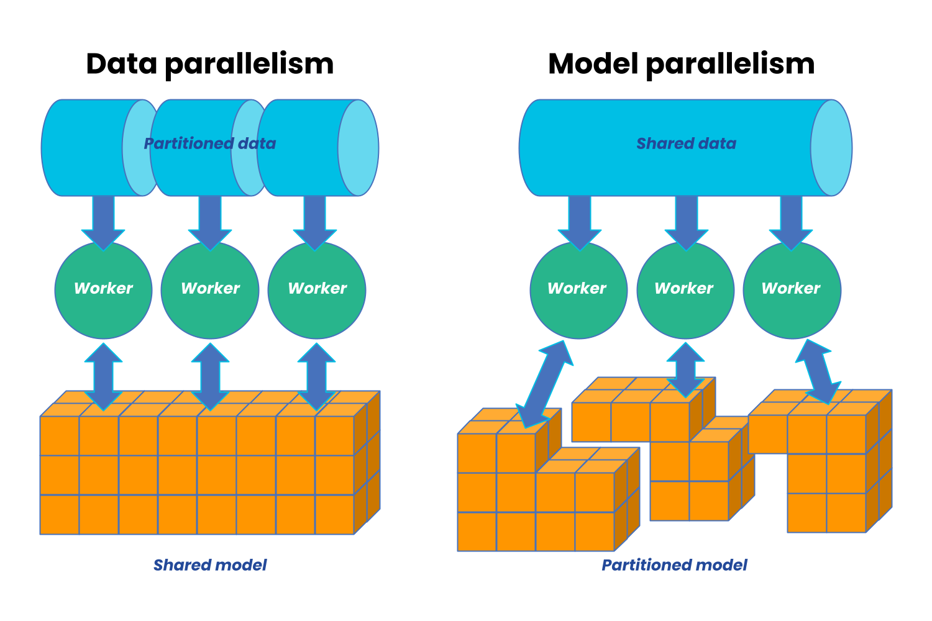
Introduction
Distributed Deep Learning (DDL) trains neural networks using multiple CPUs, GPUs, or machines working together. It overcomes the limitations of single-machine training by parallelizing computation across nodes. In data parallelism, the same model trains on different data subsets across multiple workers. In model parallelism, different parts of the network are distributed across machines. DDL improves training speed, scalability, and resource utilization for large datasets. Applications of DDL are NLP and healthcare imaging.

Slide 5
Problem Statement
The rapid advancement of smart port infrastructure has led to the deployment of high-resolution surveillance systems, generating large-scale visual datasets for maritime monitoring. Current port congestion prediction frameworks predominantly rely on centralized deep learning architectures. Centralized architectures suffer from high computational overhead and latency. The proposed solution is a distributed deep learning framework based on convolutional neural networks to analyse port images for congestion prediction and unloading time estimation. This approach ensures efficient resource utilization and reliable performance, supporting real-time smart port management with enhanced responsiveness.

Slide 6
Objective
To acquire and preprocess large-scale port surveillance images by performing data cleaning, augmentation, and labelling to create a structured dataset suitable for deep learning training.
To design and train a convolutional neural network model for extracting visual features and predicting port congestion levels and unloading time from image data.
To implement a distributed deep learning framework using data parallelism to accelerate model training and optimize computational resource utilization.

Slide 7
Literature Survey
S. No | Title | Journal / Transaction | Methodology | Limitations | Datasets Used
1 | Distributed Deep Learning with Gradient Compression for Big Remote Sensing Image Interpretation | IEEE Transactions on Neural Networks and Learning Systems, 2025 | Distributed learning with centroid-based Gradient Compression (GCC) for hyperspectral target detection on edge devices | • Requires distributed infrastructure • Centroid computation adds overhead | Xiongan New Area (Matiwan Village)AeroRITCIFAR-10
2 | Communication-Efficient Distributed Learning for Hyperspectral Image Analysis | IEEE Transactions on Geoscience and Remote Sensing, 2024 | Distributed CNN training with communication-aware optimization | • No explicit gradient compression • High bandwidth demand | Fashion-MNISTMNIST
3 | Learned Gradient Compression for Distributed Deep Learning | IEEE Transactions on Neural Networks and Learning Systems, 2022 | Neural network-based learning of optimal gradient compression patterns | • Additional model overhead • Initial training instability | CIFAR-10CIFAR-100ImageNet

Slide 8
Literature Survey
S. No | Title | Journal / Transaction | Methodology | Limitations | Datasets Used
4 | Robust and Communication-Efficient Federated Learning from Non-IID Data | IEEE Transactions on Neural Networks and Learning Systems, 2021 | Combines gradient sparsification with error-feedback mechanisms | • Focused mainly on federated learning • Limited vision-based evaluation | MNISTCIFAR-10
5 | ScaleCom: Scalable Sparsified Gradient Compression for Distributed Training | IEEE Transactions on Parallel and Distributed Systems, 2020 | Scalable gradient sparsification for large distributed clusters | • Sensitive to sparsity level • Less effective for dense gradients | CIFAR-10ImageNet
6 | Cloud Deep Networks for Hyperspectral Image Analysis | IEEE Transactions on Geoscience and Remote Sensing, 2020 | Cloud-based distributed deep learning for hyperspectral data | • High latency due to cloud dependency • Not suitable for edge deployment | SVHNSTL-10

Slide 9
Literature Survey
S. No | Title | Journal / Transaction | Methodology | Limitations | Datasets Used
7 | Communication-Efficient SGD via Gradient Sampling with Bayesian Prior | IEEE Transactions on Pattern Analysis and Machine Intelligence, 2021 | Probabilistic gradient sampling using Bayesian priors | • Sampling bias affects convergence • Computationally expensive | ImageNet-21KImageNet
8 | Joint Sparsification and Quantization for Distributed Learning | IEEE Transactions on Neural Networks and Learning Systems, 2024 | Joint gradient sparsification and quantization | • Increased algorithmic complexity • Requires careful hyperparameter tuning | Tiny ImageNetPlaces365
9 | Communication-Efficient Distributed Optimization with Error Reset | IEEE Transactions on Neural Networks and Learning Systems, 2020 | Error-reset mechanisms to stabilize compressed SGD | • Slower convergence in deep networks | Pascal VOCCOCO
10 | Distributed Deep Learning on Edge Devices: Challenges and Opportunities | IEEE Internet of Things Journal, 2023 | Survey of distributed deep learning architectures for edge and IoT systems | • No experimental validation • No algorithmic contribution | Survey Paper

Slide 10
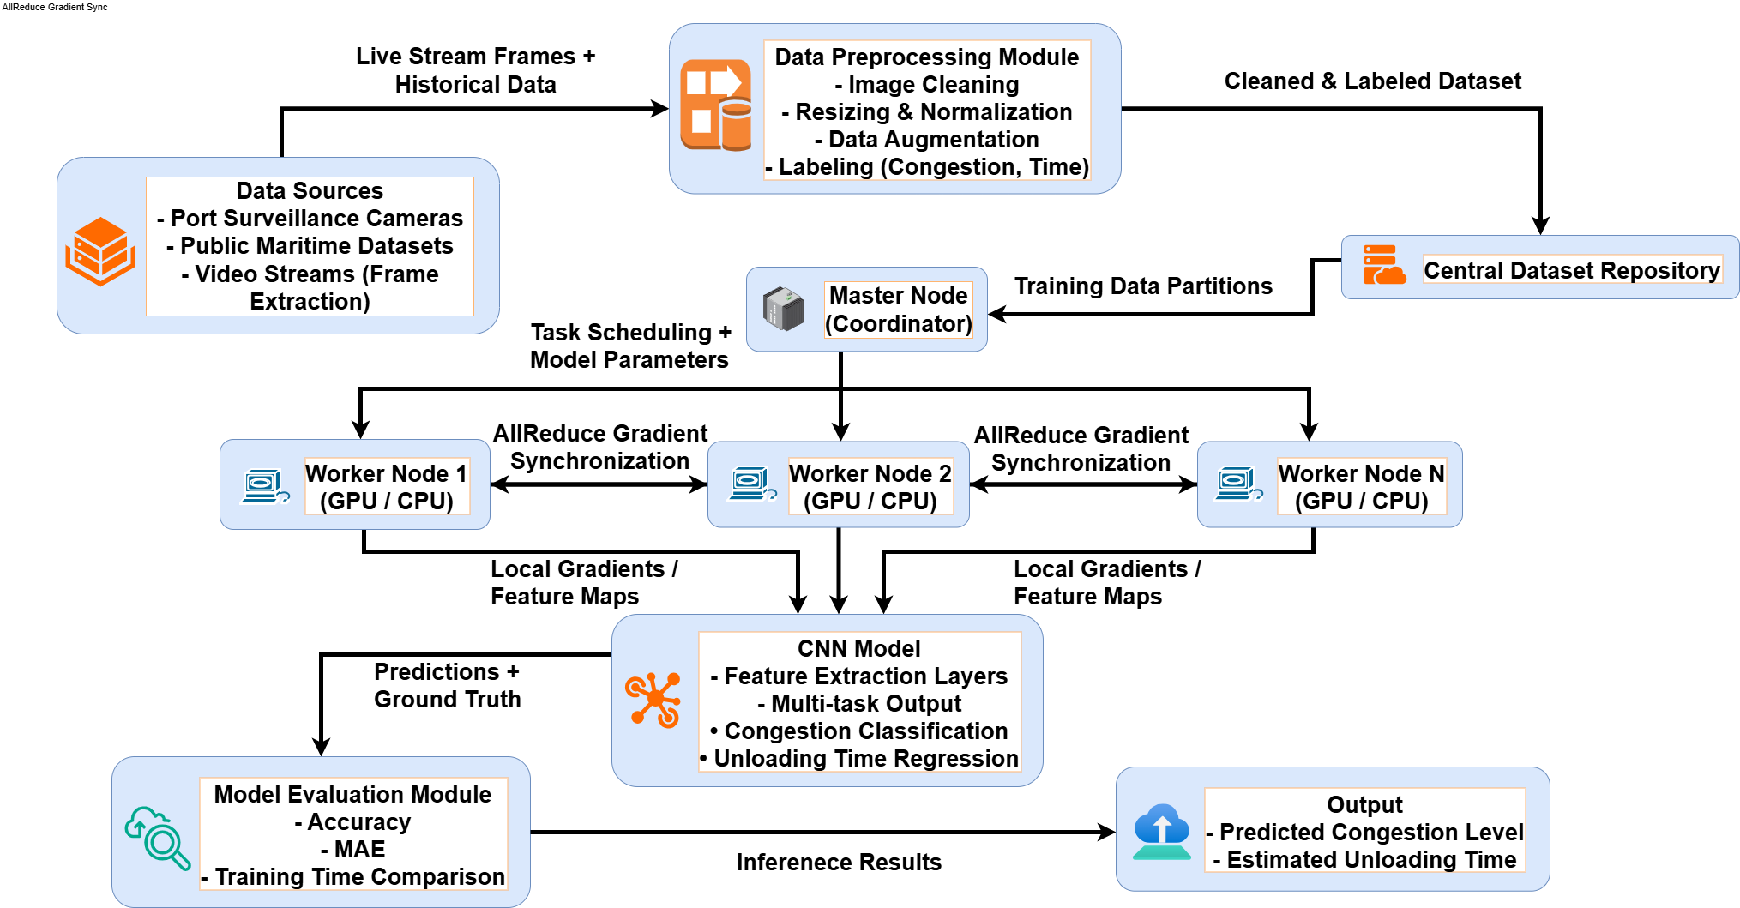
Architecture Diagram

Slide 11
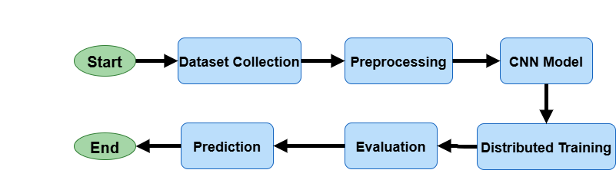
Flow Diagram

Slide 12
Modules Proposed
1. Dataset Distribution Large-scale remote sensing images are collected and distributed across multiple worker nodes for parallel processing.
2. Preprocessing Images are normalized, resized, and enhanced to improve data quality and model robustness.
3. Distributed CNN Training Each node trains a local CNN model to extract spatial features from images.
4. Gradient Compression (Core Module) Computed gradients are compressed using sparsification and/or quantization to reduce communication overhead.
5. Model Aggregation Compressed gradients are aggregated at a central server to update the global model efficiently.
6. Evaluation & Prediction The trained model is evaluated for accuracy and communication efficiency, then used for image interpretation.
Key Outcome
Reduced communication cost
Faster distributed training
Scalable and edge-friendly framework

Slide 13
Dataset Description
A. Dataset 1: Ships in Satellite Imagery (SSI)
Description: Ships in Satellite Imagery (SSI) is a labeled satellite image dataset used for ship detection
and port congestion analysis. The dataset consists of small RGB image patches indicating the presence
or absence of ships in various maritime environments.
Major Attributes:
• Image Data: 80×80 RGB satellite image patches representing different maritime scenes.
• Label: Binary annotation indicating ship presence (1) or absence (0).
• Scene ID: Unique identifier for the satellite scene from which the image was extracted.
• Geolocation (Longitude, Latitude): Coordinates of the image centre.
B. Dataset 2: ARGO Ship Classification Dataset
Description: The ARGO Ship Classification Dataset is a satellite-based maritime image dataset
designed for remote sensing classification tasks. It contains labeled ship and non-ship image patches
along with associated AIS metadata for accurate maritime analysis.
Major Attributes:
• Image: Satellite image patch containing maritime scenes (ship or non-ship).
• Label: Binary indicator denoting ship presence (ship / non_ship).
• channel_data: Four-band PlanetScope imagery (Blue, Green, Red, Near-Infrared) stored in NumPy
format.

Slide 14
Reference
[1] W. Xie et al., "Distributed Deep Learning with Gradient Compression for Big Remote Sensing Image Interpretation," in IEEE Transactions on Neural Networks and Learning Systems, vol. 36, no. 8, pp. 14328-14342, Aug. 2025, Doi: 10.1109/TNNLS.2024.3517535.
[2] J. M. Haut, M. E. Paoletti, J. Plaza, A. Plaza and J. Li, “Communication-Efficient Distributed Deep Learning for Hyperspectral Image Analysis,” IEEE Journal of Selected Topics in Applied Earth Observations and Remote Sensing, vol. 13, pp. 123–137, 2020, Doi: 10.1109/JSTARS.2019.2959437. [3] L. Abrahamyan, Y. Chen, G. Be Koulis and N. Deligiannis, "Learned Gradient Compression for Distributed Deep Learning," in IEEE Transactions on Neural Networks and Learning Systems, vol. 33, no. 12, pp. 7330-7344, Dec. 2022, Doi: 10.1109/TNNLS.2021.3084806.
[4] F. Sattler, S. Wiedemann, K. -R. Müller and W. Samek, "Robust and Communication-Efficient Federated Learning from Non-i.i.d. Data," in IEEE Transactions on Neural Networks and Learning Systems, vol. 31, no. 9, pp. 3400-3413, Sept. 2020, Doi: 10.1109/TNNLS.2019.2944481.
[5] C.-Y. Chen, J. Ni, S. Lu, X. Cui, P.-Y. Chen, X. Sun, N. Wang, S. Venkataramani, V. Srinivasan, W. Zhang and K. Gopalakrishnan, “ScaleCom: Scalable Sparsified Gradient Compression for Communication-Efficient Distributed Training,” arXiv preprint arXiv:2104.11125, 2021.
[6] J. M. Haut et al., "Cloud Deep Networks for Hyperspectral Image Analysis," in IEEE Transactions on Geoscience and Remote Sensing, vol. 57, no. 12, pp. 9832-9848, Dec. 2019, Doi: 10.1109/TGRS.2019.2929731.
[7] L. Song et al., "Communication Efficient SGD via Gradient Sampling with Bayes Prior," 2021 IEEE/CVF Conference on Computer Vision and Pattern Recognition (CVPR), Nashville, TN, USA, 2021, pp. 12060-12069, doi: 10.1109/CVPR46437.2021.01189.
[8] W. Xie et al., "JointSQ: Joint Sparsification-Quantization for Distributed Learning," 2024 IEEE/CVF Conference on Computer Vision and Pattern Recognition (CVPR), Seattle, WA, USA, 2024, pp. 5778-5787, Doi: 10.1109/CVPR52733.2024.00552.

Slide 15
Reference
[9] C. Xie, S. Zheng, O. Koyejo, I. Gupta, M. Li and H. Lin, “CSER: Communication-Efficient SGD with Error Reset,” arXiv preprint arXiv:2007.13221, 2020.
[10] Jingke Tu, Lei Yang, and Jiannong Cao., “Distributed Machine Learning in Edge Computing: Challenges, Solutions and Future Directions,” ACM Computing Surveys, vol. 57, no. 5, Article 132, May 2025, 37 pages, Doi: 10.1145/3708495..
[11] W. Xie et al., "JointSQ: Joint Sparsification-Quantization for Distributed Learning," 2024 IEEE/CVF Conference on Computer Vision and Pattern Recognition (CVPR), Seattle, WA, USA, 2024, pp. 5778-5787, Doi: 10.1109/CVPR52733.2024.00552.
[12] J. M. Haut, M. E. Paoletti, S. Moreno-Alvarez, J. Plaza, J.-A. Rico-Gallego and A. Plaza, "Distributed Deep Learning for Remote Sensing Data Interpretation," Proceedings of the IEEE, vol. 109, no. 8, pp. 1320–1349, Aug. 2021, Doi: 10.1109/JPROC.2021.3087874.
[13] T. Vogels, S. P. Karimireddy, and M. Jaggi, “PowerSGD: Practical Low-Rank Gradient Compression for Distributed Optimization,” NeurIPS, 2020.
[14] Y. Lu, K. Xie, G. Xu, H. Dong, C. Li and T. Li, "MTFC: A Multi-GPU Training Framework for Cube-CNNBased Hyperspectral Image Classification," in IEEE Transactions on Emerging Topics in Computing, vol. 9, no. 4, pp. 1738-1752, 1 Oct.-Dec. 2021, Doi: 10.1109/TETC.2020.3016978.
[15] H. Xu et al., "GRACE: A Compressed Communication Framework for Distributed Machine Learning," 2021 IEEE 41st International Conference on Distributed Computing Systems (ICDCS), DC, USA, 2021, pp. 561-572, Doi: 10.1109/ICDCS51616.2021.00060.

Slide 16
THANK YOU
For your attention

